Slide 1

Financial Fraud Detection at Scale
Big Data Analytics & MLOps using Apache Spark | IEEE-CIS Fraud Detection Dataset
GROUP 5
SATISH · SARA TARIQ · PRERNA JHA · DEBADRI SANYAL
Notes:
Hello everyone. We are Group 5 — Satish, Sara Tariq, Prerna Jha, and Debadri Sanyal. Today, we present our project: Financial Fraud Detection at Scale — built using Big Data Analytics and MLOps with Apache Spark on the IEEE-CIS Fraud Detection Dataset.

Slide 2

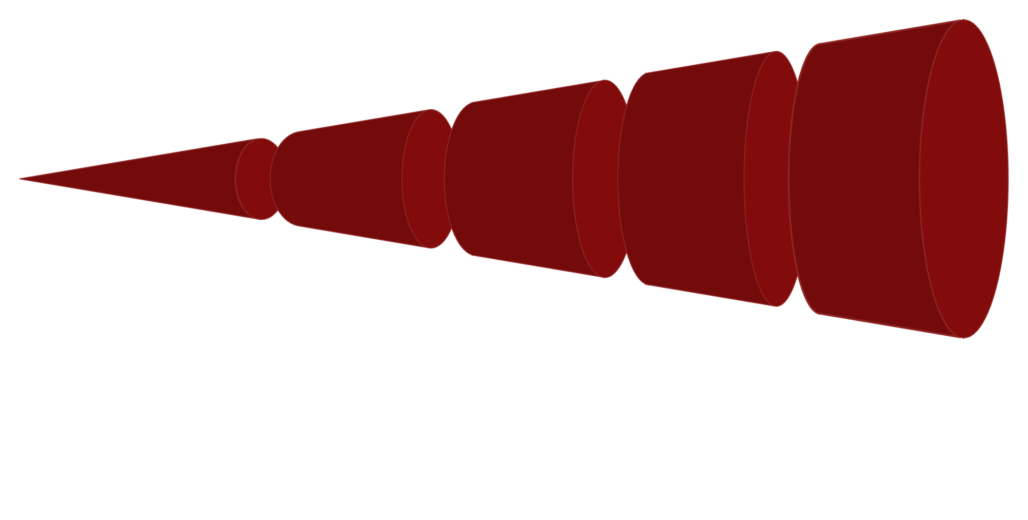
Real-time Transaction Monitoring
Machine Learning Models
Behavioral Analytics
Detect anomalies instantly
Device & Network Signals
Adaptive fraud scoring
User patterns and profiles
Investigation Workflows
IP, device fingerprinting
Case management & triage

Slide 3

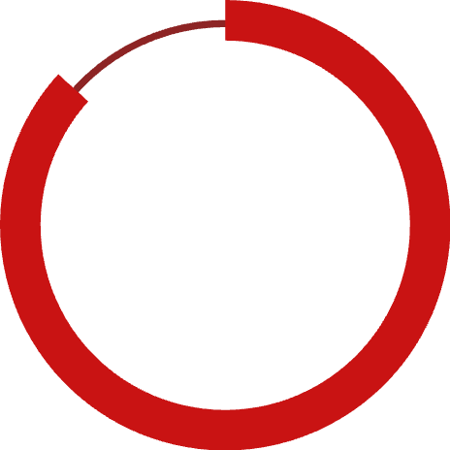


Executive Summary
A production-scale fraud detection system built on Apache Spark 4.1 and Databricks Serverless, applied to the IEEE-CIS dataset with 590,540 training and 506,692 test transactions across 400+ features. The six-phase pipeline covers problem framing, ingestion, EDA, modeling, MLOps, and business insights.
0.9460
86.7%
$1.45M
Champion AUC-ROC
Fraud Capture Rate
Net Annual Benefit
XGBoost best model
@ Threshold 0.40
Projected ROI
590K
0.6753
3
Transactions
AUC-PR Score
ML Models
Processed in Spark
Precision-Recall
Trained & tracked

Slide 4
Phase 1: Dataset Overview
The IEEE-CIS Fraud Detection dataset from Vesta Corporation contains 590K+ labeled e-commerce transactions with 434 features spanning transaction attributes, card metadata, device info, and behavioral signals.
Training Transactions
590,540 rows — train_transaction.csv + train_identity.csv
Test Transactions
506,691 rows — test_transaction.csv + test_identity.csv
Target Variable
isFraud (binary: 0 = legitimate, 1 = fraudulent)
Class Distribution
~96.5% legitimate vs. ~3.5% fraud — severely imbalanced
Raw Feature Count
394 transaction + 41 identity = 434 post-join columns
Anonymized Features
V1–V339 (Vesta behavioral signals — majority >60% null)
Data Format
CSV → Unity Catalog Volume → Delta Lake tables

Slide 5
Business Problem & Success KPIs
"How can financial institutions leverage large-scale transaction data processed through Apache Spark to detect fraudulent activity, enabling risk-scoring models that minimize financial losses while reducing false positives that harm legitimate customers?"
Why It Matters
Success KPIs
Global card fraud losses exceeded $33B in 2023, growing ~15% YoY
Rule-based systems cannot scale to billions of transactions or adapt to evolving fraud
Each false positive costs $8–$12 in service, relationship damage, and churn
CNP fraud, synthetic identity, and account-takeover attacks bypass static rules within days
KPI
Target
Rationale
AUC-ROC (primary)
> 0.90
Imbalanced benchmark
Precision @ ≥75% recall
> 0.85
Balances capture vs. friction
MLflow model variants
≥ 3 runs
Reproducibility & audit
EDA visualizations
≥ 8
Business communication
Business ROI
$ value
Executive decision value
Data pipeline coverage
590K+ rows
True big-data scale

Slide 6
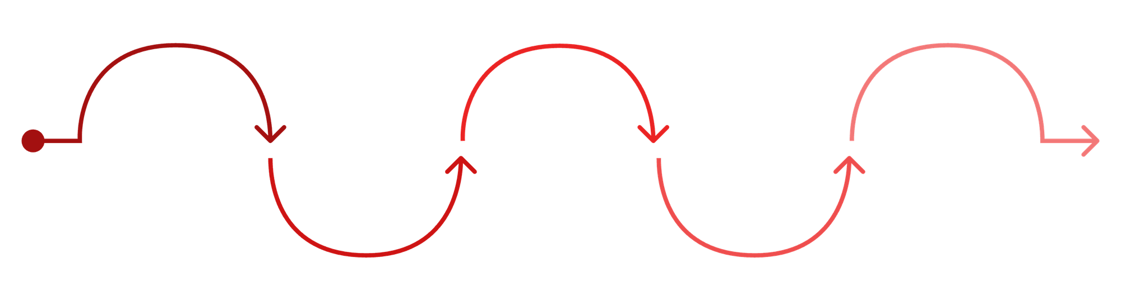
Phase 2: Data Ingestion & Preprocessing
All four CSV files were ingested into managed Delta Lake tables via Spark's native CSV reader. A LEFT JOIN on TransactionID preserved all 590,540 transactions while enriching 144,233 records with identity signals. Post-join validation confirmed zero duplicates.
Null Analysis
Median Impute
Deduplication
Drop High-Null
Mode Impute
322 of 434 columns >5% missing
Imputed 10 categorical columns
Imputed 104 numeric columns
dropDuplicates(TransactionID) — 0 removed
208 cols >60% null dropped (434→226)
Categorical Encoding (LabelEncoder)
Delta Layer Architecture
Column
Encoded As
Distinct Values
Table
Rows
Cols
Layer
ProductCD
ProductCD_idx
5 (W,H,C,S,R)
fraud_train_clean
590,540
48
Silver
card4
card4_idx
5 networks
fraud_test_clean
506,691
47
Silver
card6
card6_idx
5 types
fraud_features_train
590,540
44
Gold
DeviceType
DeviceType_idx
3 channels
fraud_features_test
506,691
43
Gold
P_emaildomain
P_emaildomain_idx
59 domains

Slide 7

Phase 3: EDA — Summary Statistics & Class Imbalance
TransactionAmt by Fraud Label
Class Distribution
isFraud
Count
Mean
Median
Std Dev
Max
0 (Legit)
569,877
134.51
68.50
239.40
31,937
1 (Fraud)
20,663
149.24
75.00
232.21
5,191
Legitimate (96.5%)·96.48%
·96.48%
·
Fraud (3.5%)·3.52%
·3.52%
·
Fraudulent transactions have a slightly higher mean ($149 vs $134) and median ($75 vs $68), with a heavier upper tail — suggesting fraudsters target higher-value transactions.

Slide 8
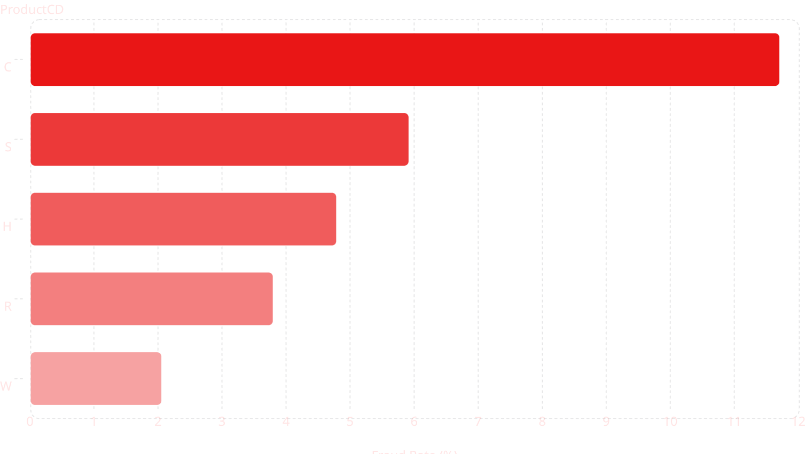
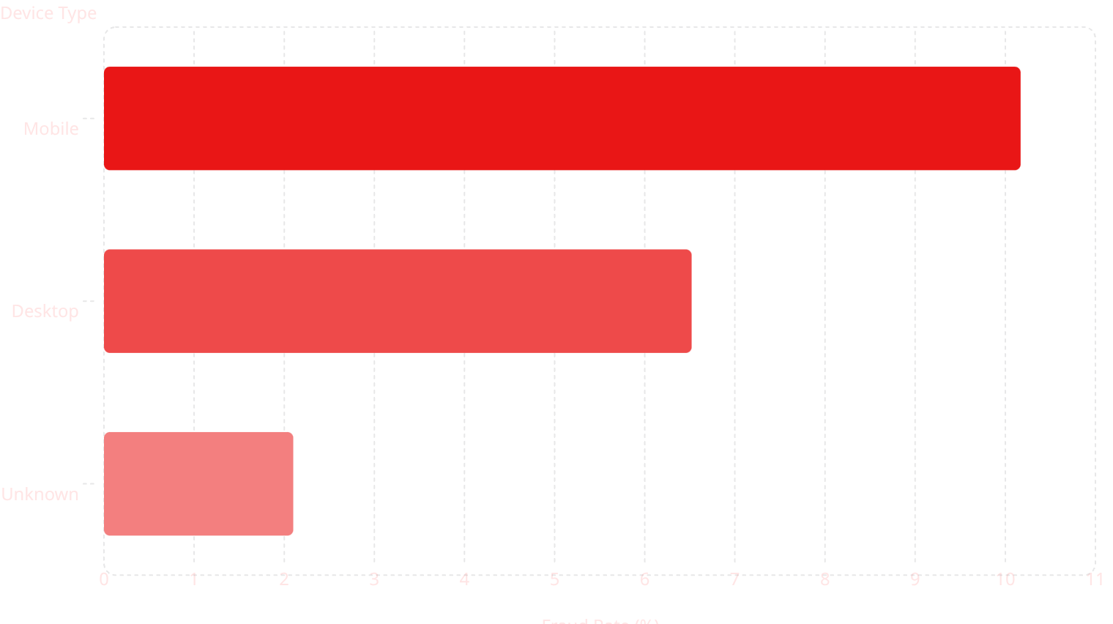
EDA — Fraud Rates by Category & Device
Fraud Rate by ProductCD
Fraud Rate by Device Type
Product C carries the highest fraud rate (11.69%) — nearly 6× the baseline. Mobile transactions show 10.17% fraud vs. 6.52% for desktop. Unknown device records form a distinct lower-risk group at 2.10%.

Slide 9
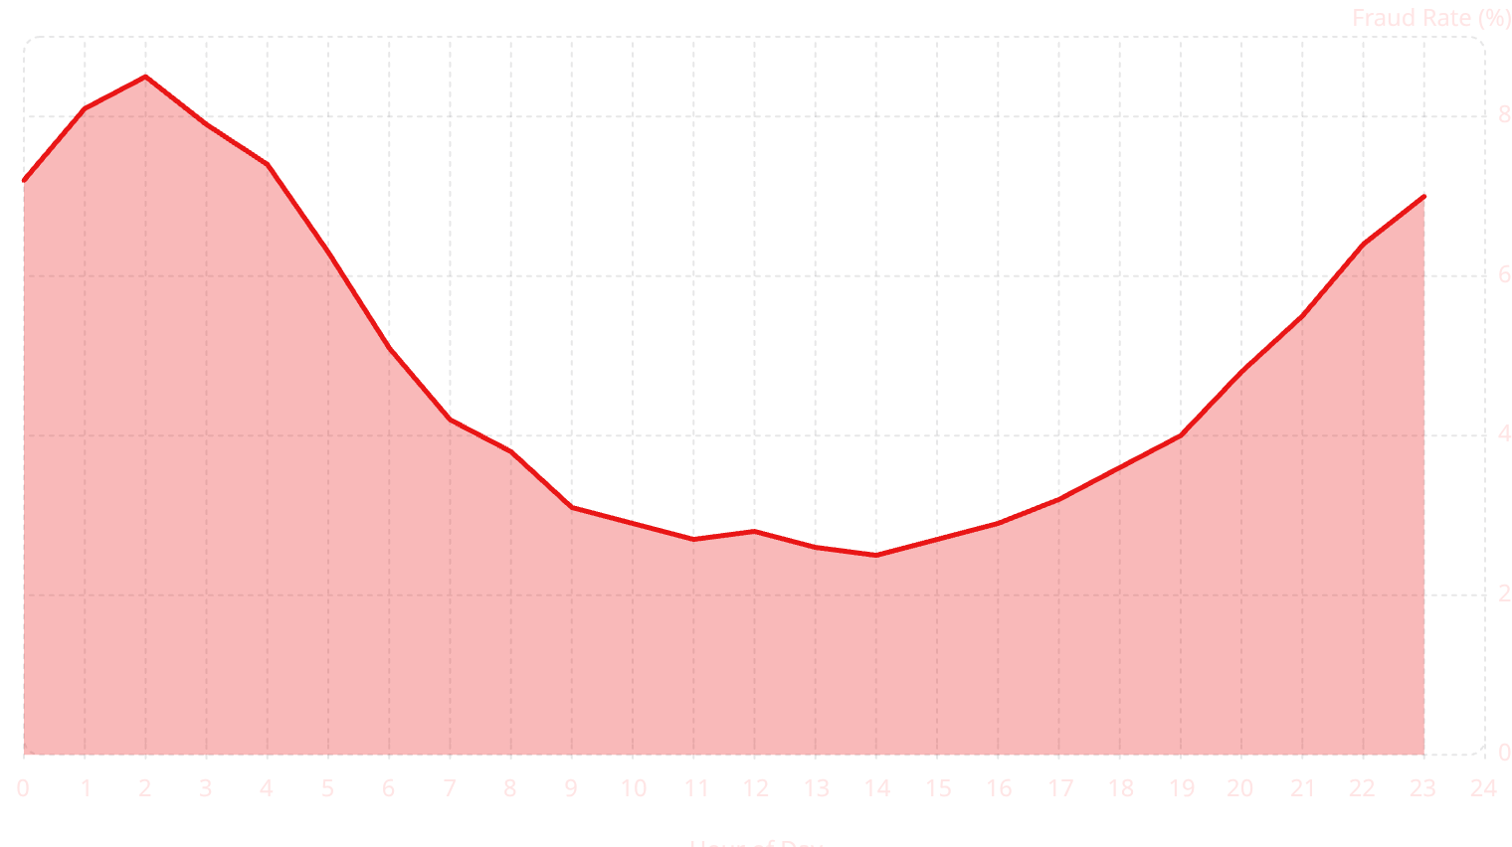
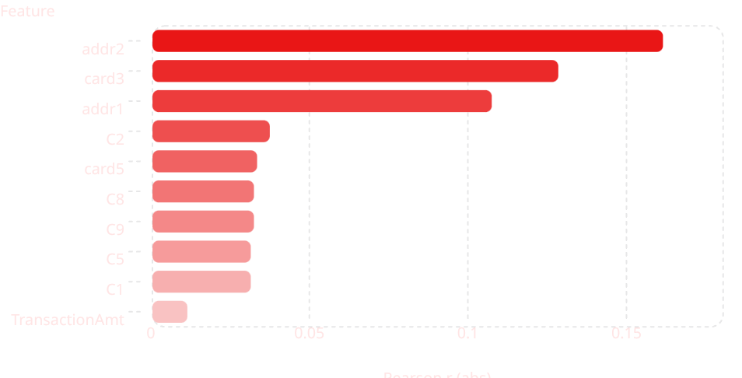
EDA — Temporal Patterns & Feature Correlations
Fraud Rate by Hour of Day
Top Feature Correlations with isFraud
Fraud peaks at midnight–5am and again after 10pm. Daytime (9am–5pm) shows suppressed rates. Geographic features addr2 and addr1 are the strongest linear predictors; TransactionAmt is weak (r=0.011).

Slide 10
Key EDA Insights for Business Decision-Making
1. Class Imbalance Requires Specialized Metrics
2. Higher-Value Transactions = Elevated Risk
At 3.5% fraud prevalence, accuracy is misleading. Prioritize AUC-ROC, AUC-PR, and fraud capture rate.
Fraudsters target larger amounts. Apply tiered authentication (OTP/manual review) for high-value transactions.
3. Product Category & Device Type Are Strong Signals
4. Email Domain & Temporal Patterns Enable Fast Pre-Screening
Product C (11.69%) and mobile (10.17%) are high-risk. Device-aware and product-specific thresholds improve precision.
Domain-level watchlists and time-of-day thresholds improve detection at near-zero operational cost.
5. C-Series Behavioral Features Are Top Predictors
6. Missing Identity Signals Are Themselves a Risk Indicator
Transaction frequency signals (C1–C14) outperform most raw attributes. Monitor PSI > 0.20 for drift alerts.
High null rates in identity fields reflect incomplete verification. Encourage stronger identity checks for risky segments.

Slide 11
Phase 4: Modeling Pipeline & Feature Engineering
Pipeline Parameters
43-Feature Engineering Matrix
Parameter
Value
Feature Group
Count
Features
Total samples
590,540 (no sub-sampling)
Transaction Core
7
TransactionAmt, ProductCD, dist1/2, hour_of_day
Feature columns
43 numeric features
Card Attributes
6
card1–card6 (type, bank, country)
Train/Val split
80% / 20% stratified
Address Signals
2
addr1 (ZIP bin), addr2 (country code)
Training rows
472,432 (~16,535 fraud)
Validation rows
118,108 (~4,134 fraud)
Email Domains
2
P_emaildomain, R_emaildomain (encoded)
Preprocessing
StandardScaler (train only)
Random seed
42 (all models)
C-Series Counts
14
C1–C14: entity transaction frequency
D-Series Deltas
6
D1–D6: days since last transaction
M-Series Matches
6
M1–M6: name/address/zip match flags

Slide 12
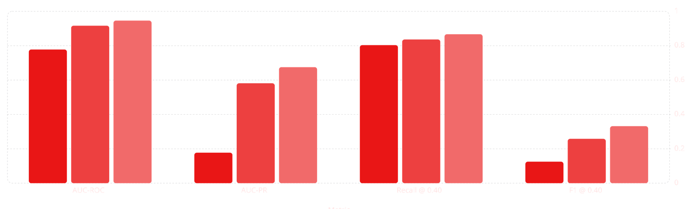
Three-Model Strategy: Results Comparison
Three models were trained in deliberate progression — interpretable baseline → strong ensemble → champion. Class imbalance addressed via class_weight='balanced' (LR/RF) and scale_pos_weight=26.6 (XGBoost).
Logistic Regression
Random Forest
XGBoost
Logistic Regression
Random Forest
XGBoost Champion
AUC-ROC: 0.7779 ❌Precision @ 0.40: 6.79%
C=0.1, saga, balanced
AUC-ROC: 0.9164 ✓
Precision @ 0.40: 15.28%
n=200, depth=12, balanced
AUC-ROC: 0.9460 ⭐Precision @ 0.40: 20.52%
depth=6, n=400, lr=0.1

Slide 13
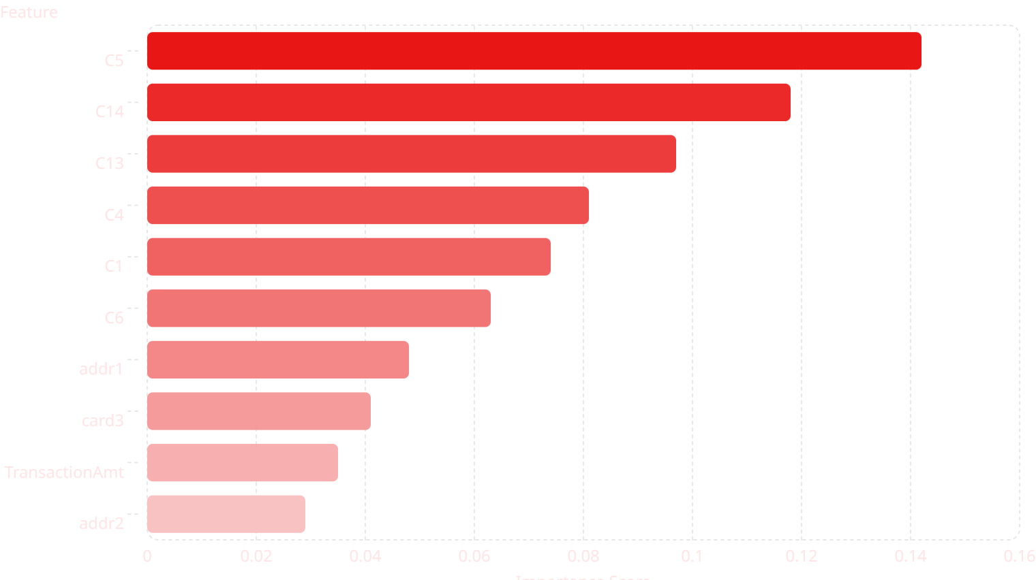
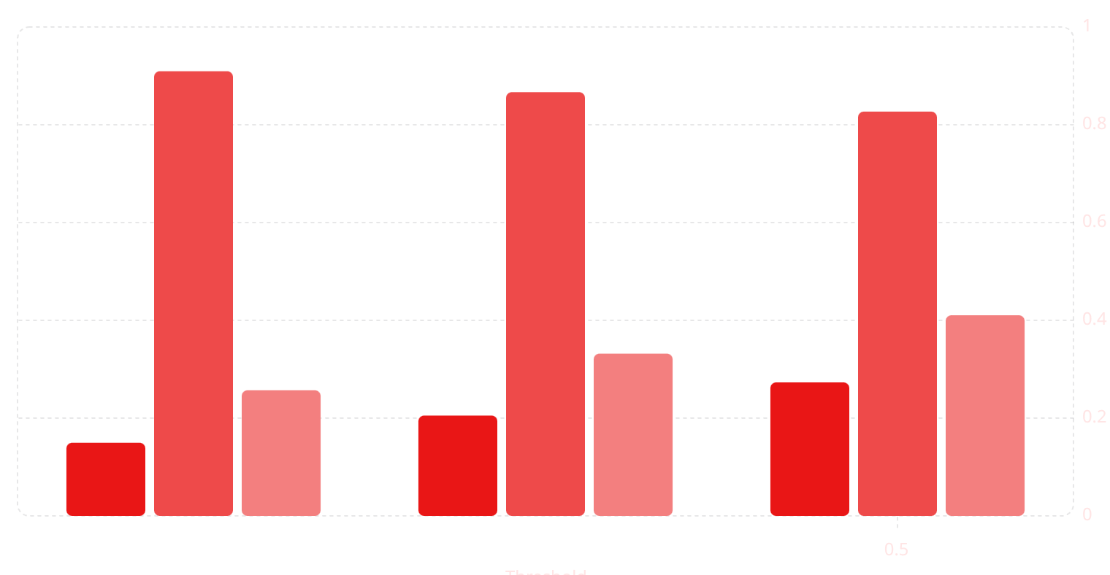
XGBoost Champion: Threshold Analysis & Feature Importance
Threshold Analysis (Best Estimator)
Top Feature Importance (XGBoost)
Precision
Recall
F1 Score
Threshold 0.40 chosen: 86.7% recall, 20.5% precision (5.9× base rate), F1=0.3319. Lower thresholds flood the review queue; higher thresholds miss more fraud.

Slide 14
XGBoost: Confusion Matrix & Hyperparameter Tuning
Confusion Matrix (Validation Set — 118,108 rows)
GridSearchCV Hyperparameter Optimization
Cell
Count
% Val
Business Meaning
Hyperparameter
Grid Values
Best
Impact
max_depth
[4, 6]
6
Bias-variance balance
True Negatives (TN)
109,876
93.03%
Correctly approved — zero friction
n_estimators
[200, 400]
400
Improves AUC
False Positives (FP)
13,580
11.50%
Legit flagged — manual review cost
learning_rate
0.1 fixed
0.1
Stable convergence
scale_pos_weight
Auto
~27
Handles 27:1 imbalance
False Negatives (FN)
546
0.46%
Missed fraud — 13.3% of actual fraud
tree_method
hist fixed
hist
Efficient on tabular data
True Positives (TP)
3,575
3.03%
Fraud caught — 86.7% capture rate
3-fold stratified CV over 4-combination grid = 12 fits. Best CV AUC-ROC: 0.9387. Validation AUC-ROC: 0.9460.

Slide 15
Phase 5: MLOps — Tracking & Deployment
MLflow Experiment Configuration
3-Tier Risk Classification Architecture
Component
Detail
Tier
Threshold
Decision
Transactions
% Total
Tracking Server
Databricks (USE_DATABRICKS=True)
LOW RISK
< 0.40
AUTO-APPROVE
434,448
85.8%
MLflow Version
2.13.2 vanilla override
MEDIUM RISK
0.40–0.85
MANUAL REVIEW
58,171
11.5%
Experiment Name
fraud_detection_project
HIGH RISK
≥ 0.85
AUTO-DECLINE
14,072
2.8%
Runs Logged
5 total (3 final + 2 GridSearchCV)
Model Persistence
gbt_champion.pkl + scaler.pkl
Deployed as a widget-parameterized Databricks notebook scoring all 506,691 test transactions. Tier boundaries minimize review queue burden while maximizing high-confidence auto-decisions.
Custom Metrics
AUC-ROC, AUC-PR, fraud_capture_pct, P, R, F1

Slide 16
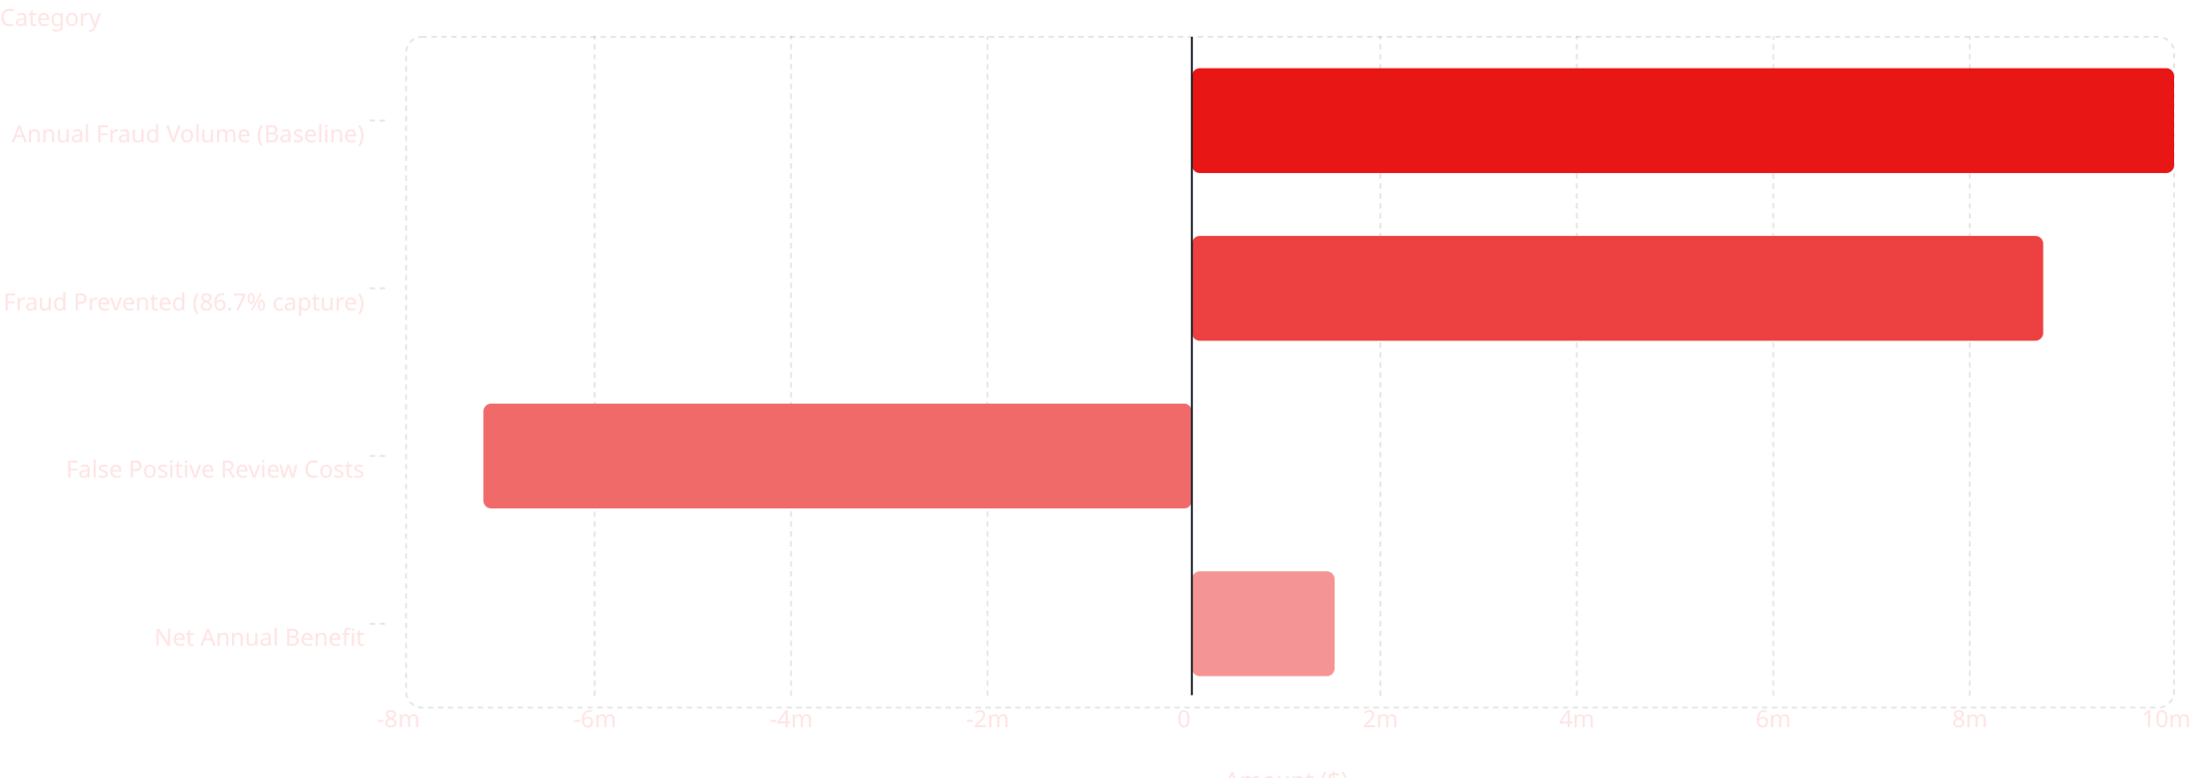
Business Impact Quantification
Projected annual financial impact of deploying XGBoost champion vs. no-model baseline. Assumptions: $10M annual fraud volume, $10 per false-positive manual review cost.
$8.67M
721K
$1.45M
Fraud Prevented
Annual FP Reviews
Net Annual Benefit
86.7% of $10M baseline
Scaled to $10M volume
ROI vs. no-model baseline

Slide 17
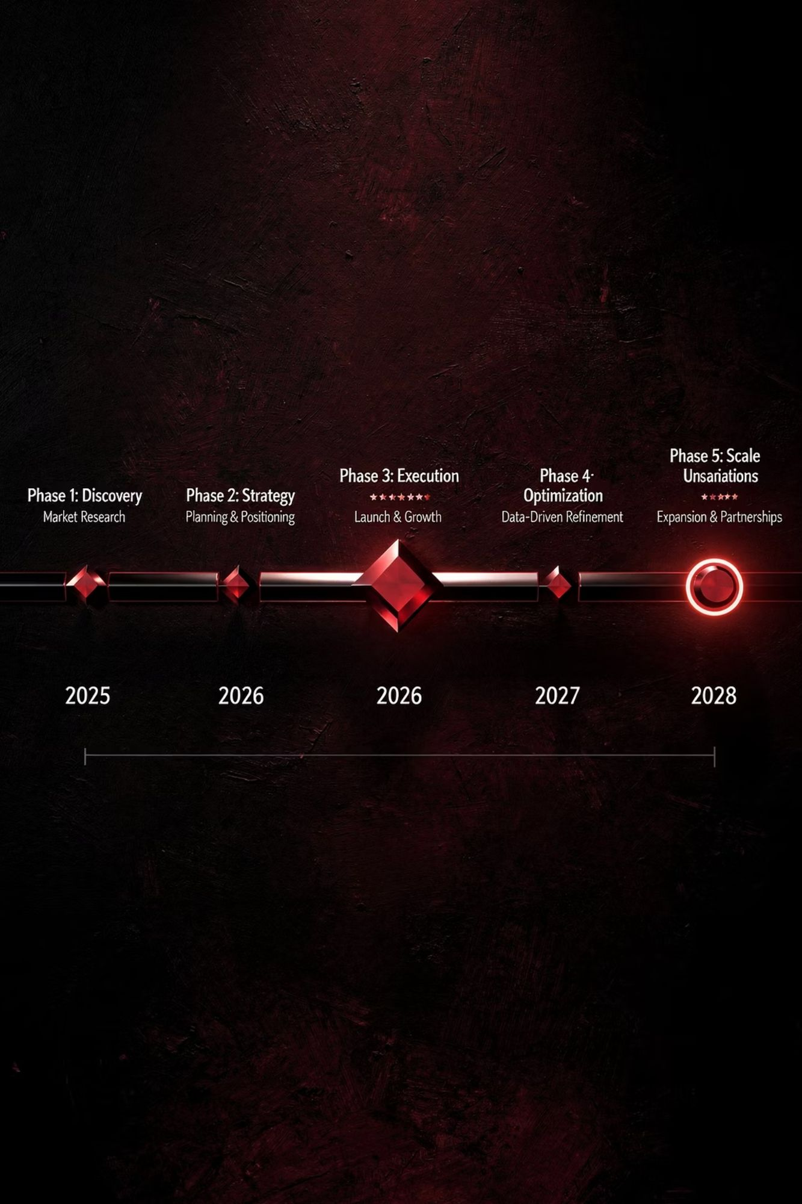
Phase 6: Actionable Business Recommendations
1
0–3 Months
Deploy XGBoost 3-tier system. Add email domain pre-screening. Set weekly C-series PSI drift alerts. Apply device-type risk routing with stricter mobile/unknown thresholds.
2
3–12 Months
Implement time-of-day thresholding. Add secondary precision classifier for MEDIUM_RISK (reduce review queue 20–30%). Deploy SHAP explanations. Optimize via SMOTE to raise precision to 30–35%.
3
12+ Months
Real-time pre-settlement scoring. Unsupervised autoencoder for zero-day fraud. Graph Neural Network for coordinated fraud rings. Online learning with automated drift detection.

Slide 18

Challenges, Lessons Learned & Future Work
Key Challenges & Mitigations
Future Work Priorities
Challenge
Mitigation
Outcome
#
Extension
Impact
Effort
3.5% class imbalance
scale_pos_weight=26.6; AUC-ROC/PR metrics only
86.7% recall achieved
1
Recover V-series via iterative imputation
+1–3pp AUC-ROC
Medium
2
SHAP explanations for MEDIUM_RISK queue
20–30% analyst efficiency
Low
55% of 434 cols >60% null
Drop >60%; median/mode impute; fillna(0)
434→43 features; AUC=0.946
3
Secondary precision layer (0.40–0.60 band)
+10–15pp precision
Medium
MLflow gRPC conflicts
mlflow==2.13.2 vanilla; USE_DATABRICKS=True
All runs logged correctly
4
Real-time streaming inference
Pre-settlement blocking
High
V-series features dropped
Documented; future iterative imputation
AUC could reach 0.96–0.97
5
Graph Neural Network / Autoencoder
Zero-day & ring detection
Very High
Py4J network errors in RF
Verified cosmetic; training completed
RF AUC-ROC = 0.9164
Lessons Learned: Data quality matters more than model tuning. Use AUC-ROC and fraud capture — not accuracy. MLOps tracking saves costly retrains. Constraints (Free Edition) forced durable, auditable architecture.

Slide 19

Conclusion
This project demonstrates that scalable, production-grade fraud detection is achievable on cloud-native big data platforms. By combining rigorous preprocessing, feature engineering, and advanced machine learning, the system effectively distinguishes fraudulent from legitimate transactions while informing a risk-based decision strategy that balances automation and manual review.
Technical Excellence
XGBoost AUC-ROC 0.9460, AUC-PR 0.6753 — 19 points above logistic regression baseline across 590K transactions.
Business Value
$1.45M projected net annual benefit via 3-tier risk architecture with 86.7% fraud capture rate.
MLOps Maturity
5 pipeline phases, full MLflow tracking, Delta Lake versioning, reproducible artifacts, and champion model persistence.
Future-Ready
Roadmap includes real-time scoring, GNN fraud ring detection, and online learning for continuous adaptation to emerging threats.

